Slide 1
Book1
File created on: 27-01-2025 05:29:19

Slide 2
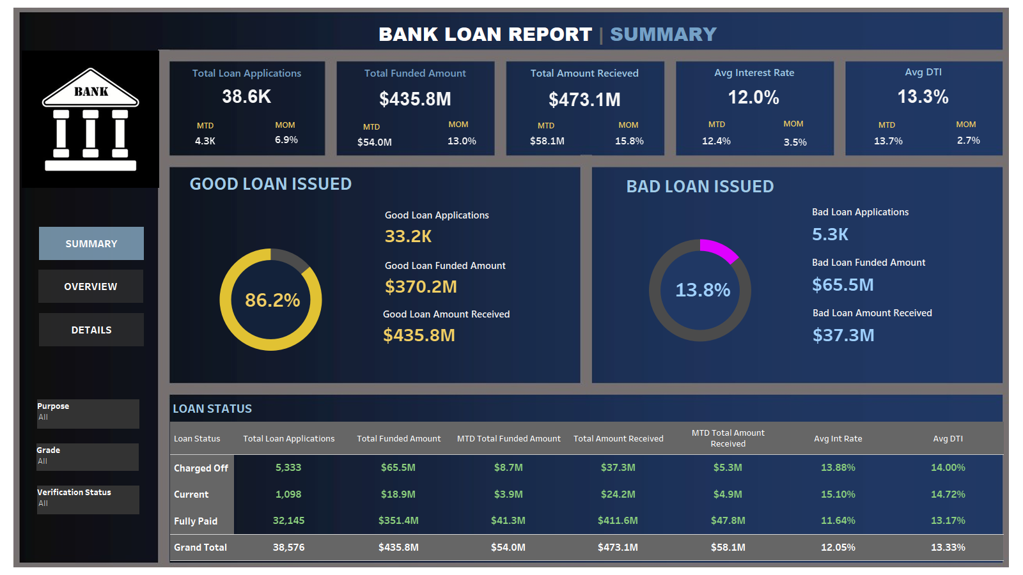

Slide 3
